Slide 1
디자인 구성 시연
작성자 : 유혜정

Slide 2
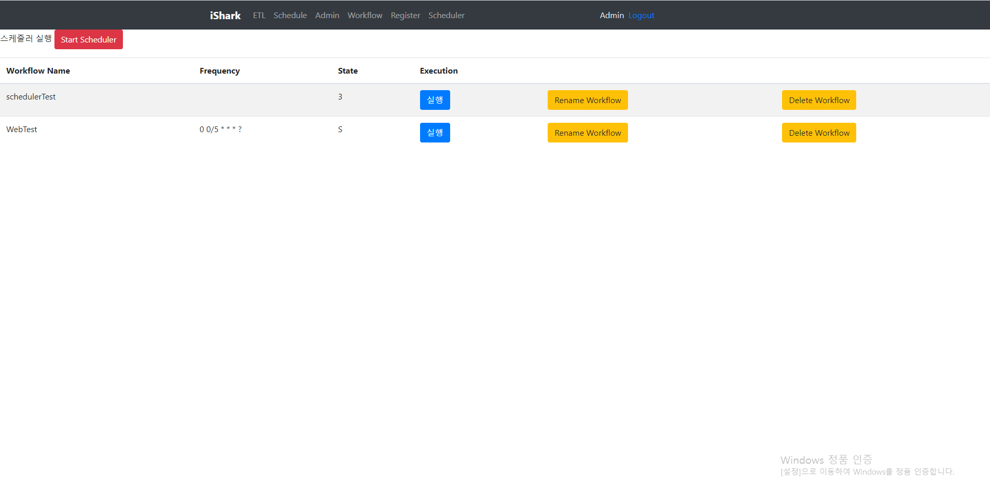
Scheduler
Off
On
Status
Workflow Name
Frequency
3
S
S
S
wf_name1
wf_name2
wf_name3
wf_name4
Rename
Delete
0 0/5 * * * ?
0 0 0/5 * * ?
0 0 0/5 * * ?
0 0 0/5 * * ?
Rename
Delete
Rename
Delete
Rename
Delete

Slide 3
Scheduler
Off
On
Status
Workflow Name
Frequency
3
S
S
S
wf_name1
wf_name2
wf_name3
wf_name4
Rename
Delete
0 0/5 * * * ?
0 0 0/5 * * ?
0 0 0/5 * * ?
0 0 0/5 * * ?
Rename
Delete
Rename
Delete
Rename
Delete

Slide 4
Scheduler
Off
On
Status
Workflow Name
Frequency
3
S
S
S
wf_name1
wf_name2
wf_name3
wf_name4
Rename
Delete
0 0/5 * * * ?
0 0 0/5 * * ?
0 0 0/5 * * ?
0 0 0/5 * * ?
Minute Hour Day Month Week
0/5
*
*
*
?
* Per Minute
0/1 From ( ) Minute Start Per ( ) Minute
0-1 ( ) Minute To ( ) Per Minute
Specified ( 0 ) Minute
0
5
삭제 취소 저장
Rename
Delete
Rename
Delete
Rename
Delete

Slide 5
Scheduler
Off
On
Status
Workflow Name
Frequency
3
S
S
S
wf_name1
wf_name2
wf_name3
wf_name4
Rename
Delete
0 0/5 * * * ?
0 0 0/5 * * ?
0 0 0/5 * * ?
0 0 0/5 * * ?
Minute Hour Day Month Week
0/5
*
*
*
?
* Per Day ? Any Day
0/1 From ( ) Day Start Per ( ) Day
0-1 ( ) Day To ( ) Per Day
Specified ( 0 ) Day
삭제 취소 저장
Rename
Delete
Rename
Delete
Rename
Delete

Slide 6
Scheduler
Off
On
Status
Workflow Name
Frequency
3
S
S
S
wf_name1
wf_name2
wf_name3
wf_name4
Rename
Delete
0 0/5 * * * ?
0 0 0/5 * * ?
0 0 0/5 * * ?
0 0 0/5 * * ?
Minute Hour Day Month Week
0/5
*
*
*
?
* Every Day
? Any Day
Selected Days of the Week
일
월
화
수
목
금
토
삭제 취소 저장
Rename
Delete
Rename
Delete
Rename
Delete

Slide 7
Scheduler
Off
On
Status
Workflow Name
Frequency
3
S
S
S
wf_name1
wf_name2
wf_name3
wf_name4
Rename
Delete
0 0 0/5 * * ?
0 0 0/5 * * ?
0 0 0/5 * * ?
Rename
Delete
Rename
Delete
Rename
Delete

Slide 8
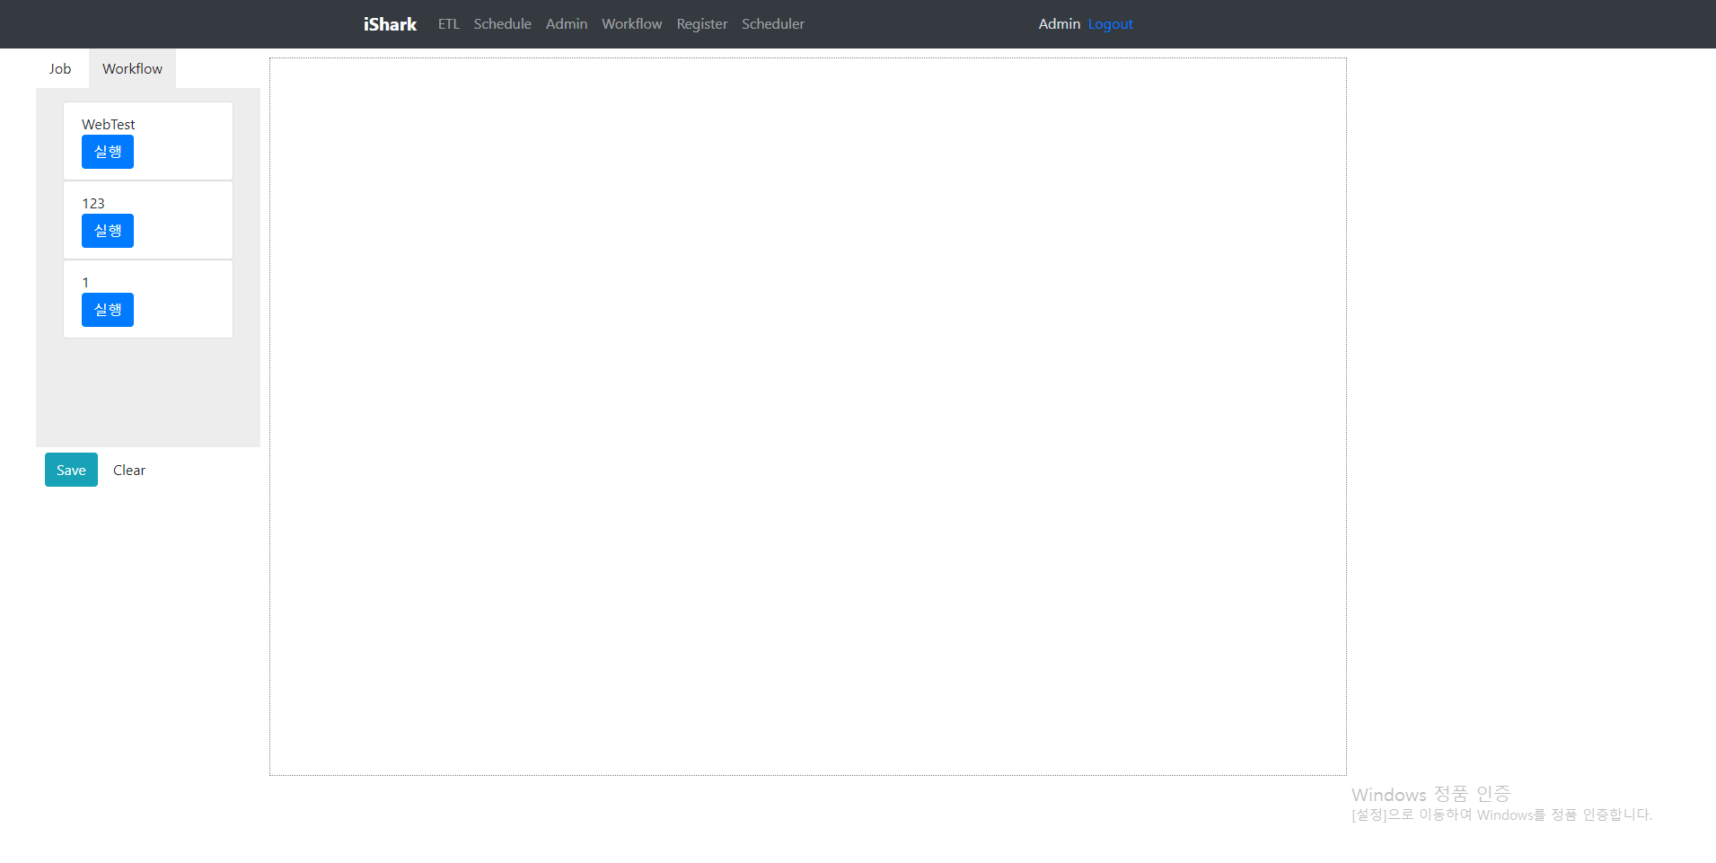
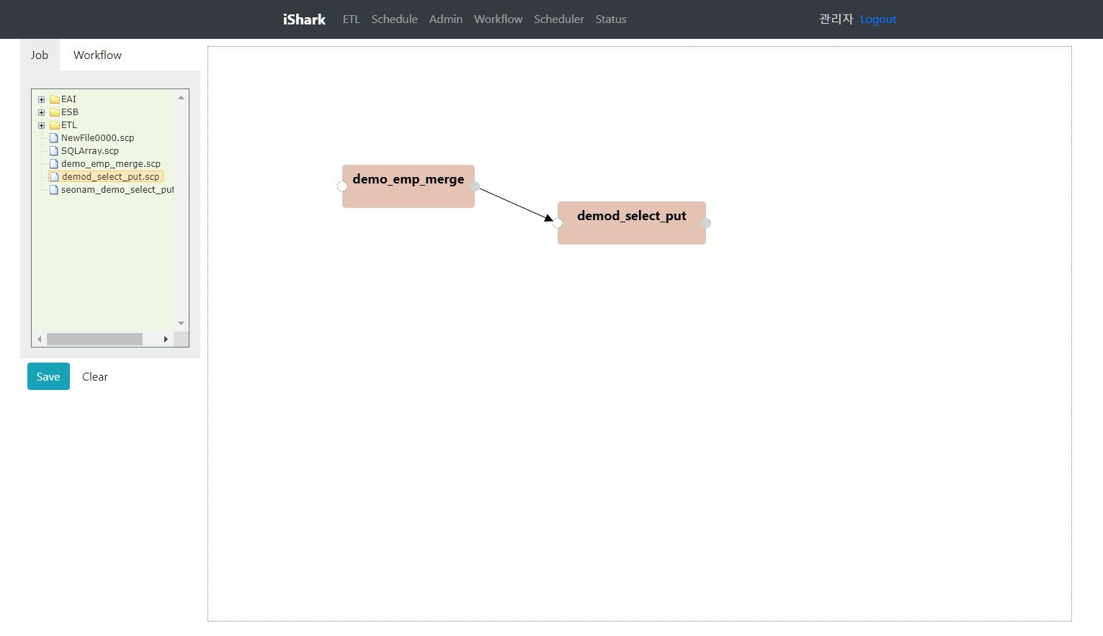

Register
wf_name1
wf_name2
wf_name3
wf_name4
wf_name5
wf_name6

Slide 9
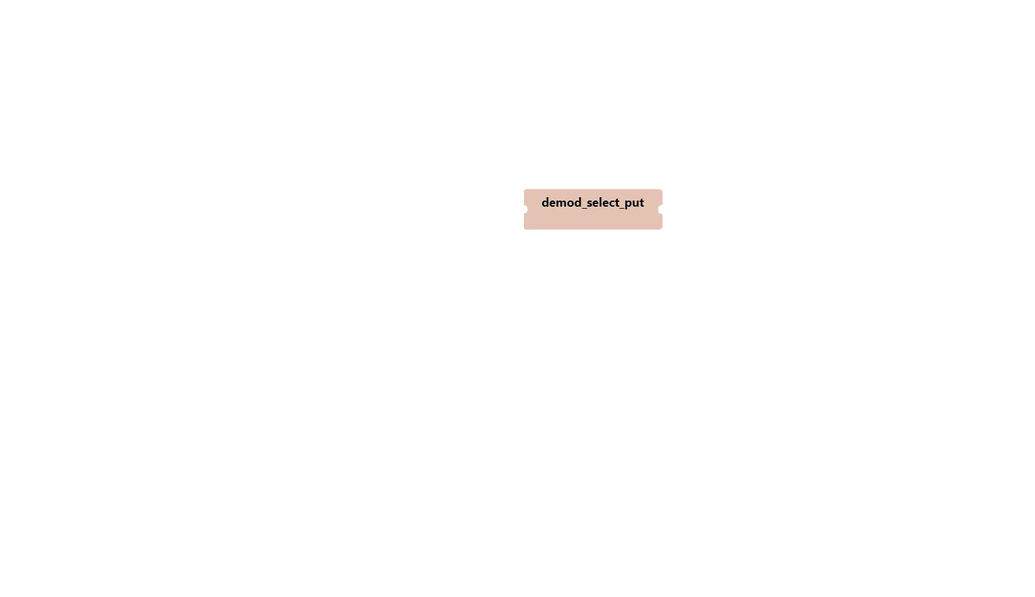
Register
wf_name1
wf_name2
wf_name3
wf_name4
X
>
wf_name5
wf_name6

Slide 10
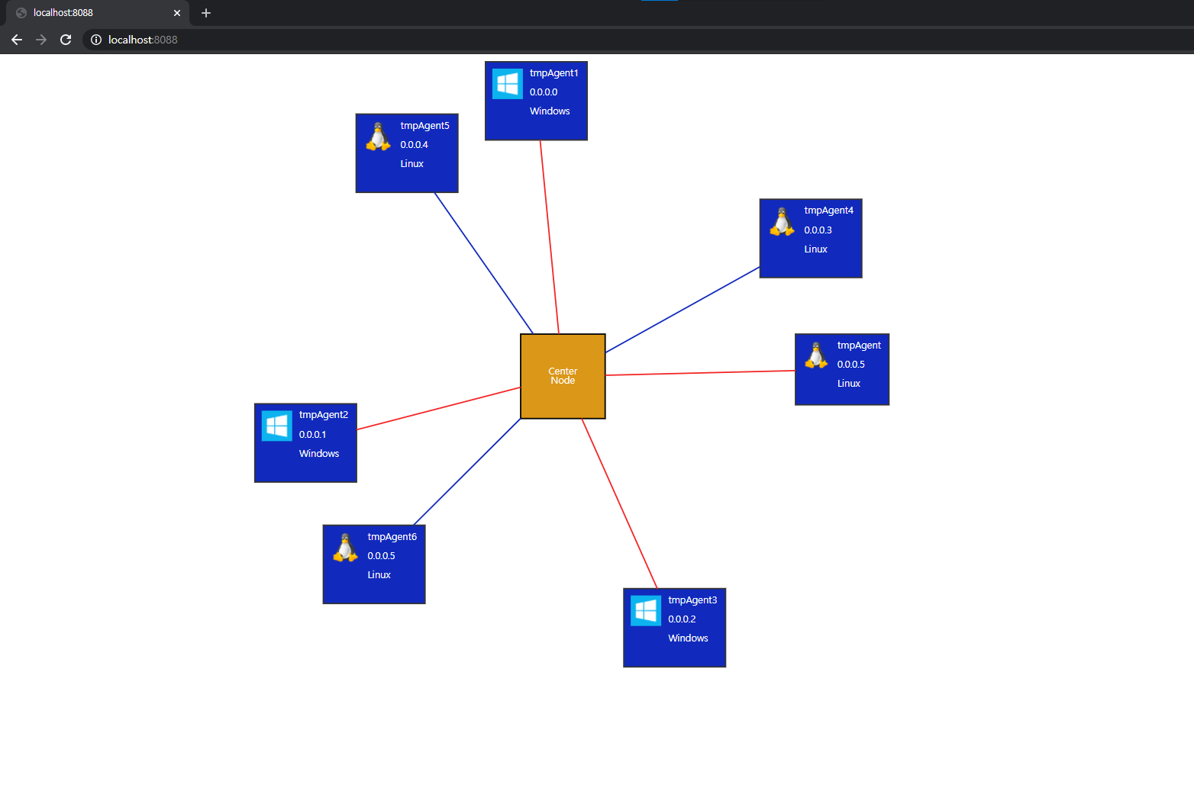
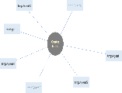
모니터링 부분(AS-IS)
모니터링 부분(TO-BE)
tmpAgent3
tmpAgent0
tmpAgent2
Center Node
색상
자동 V
자동
수동
tmpAgent1
tmpAgent4
tmpAgent5
tmpAgent6

Slide 11
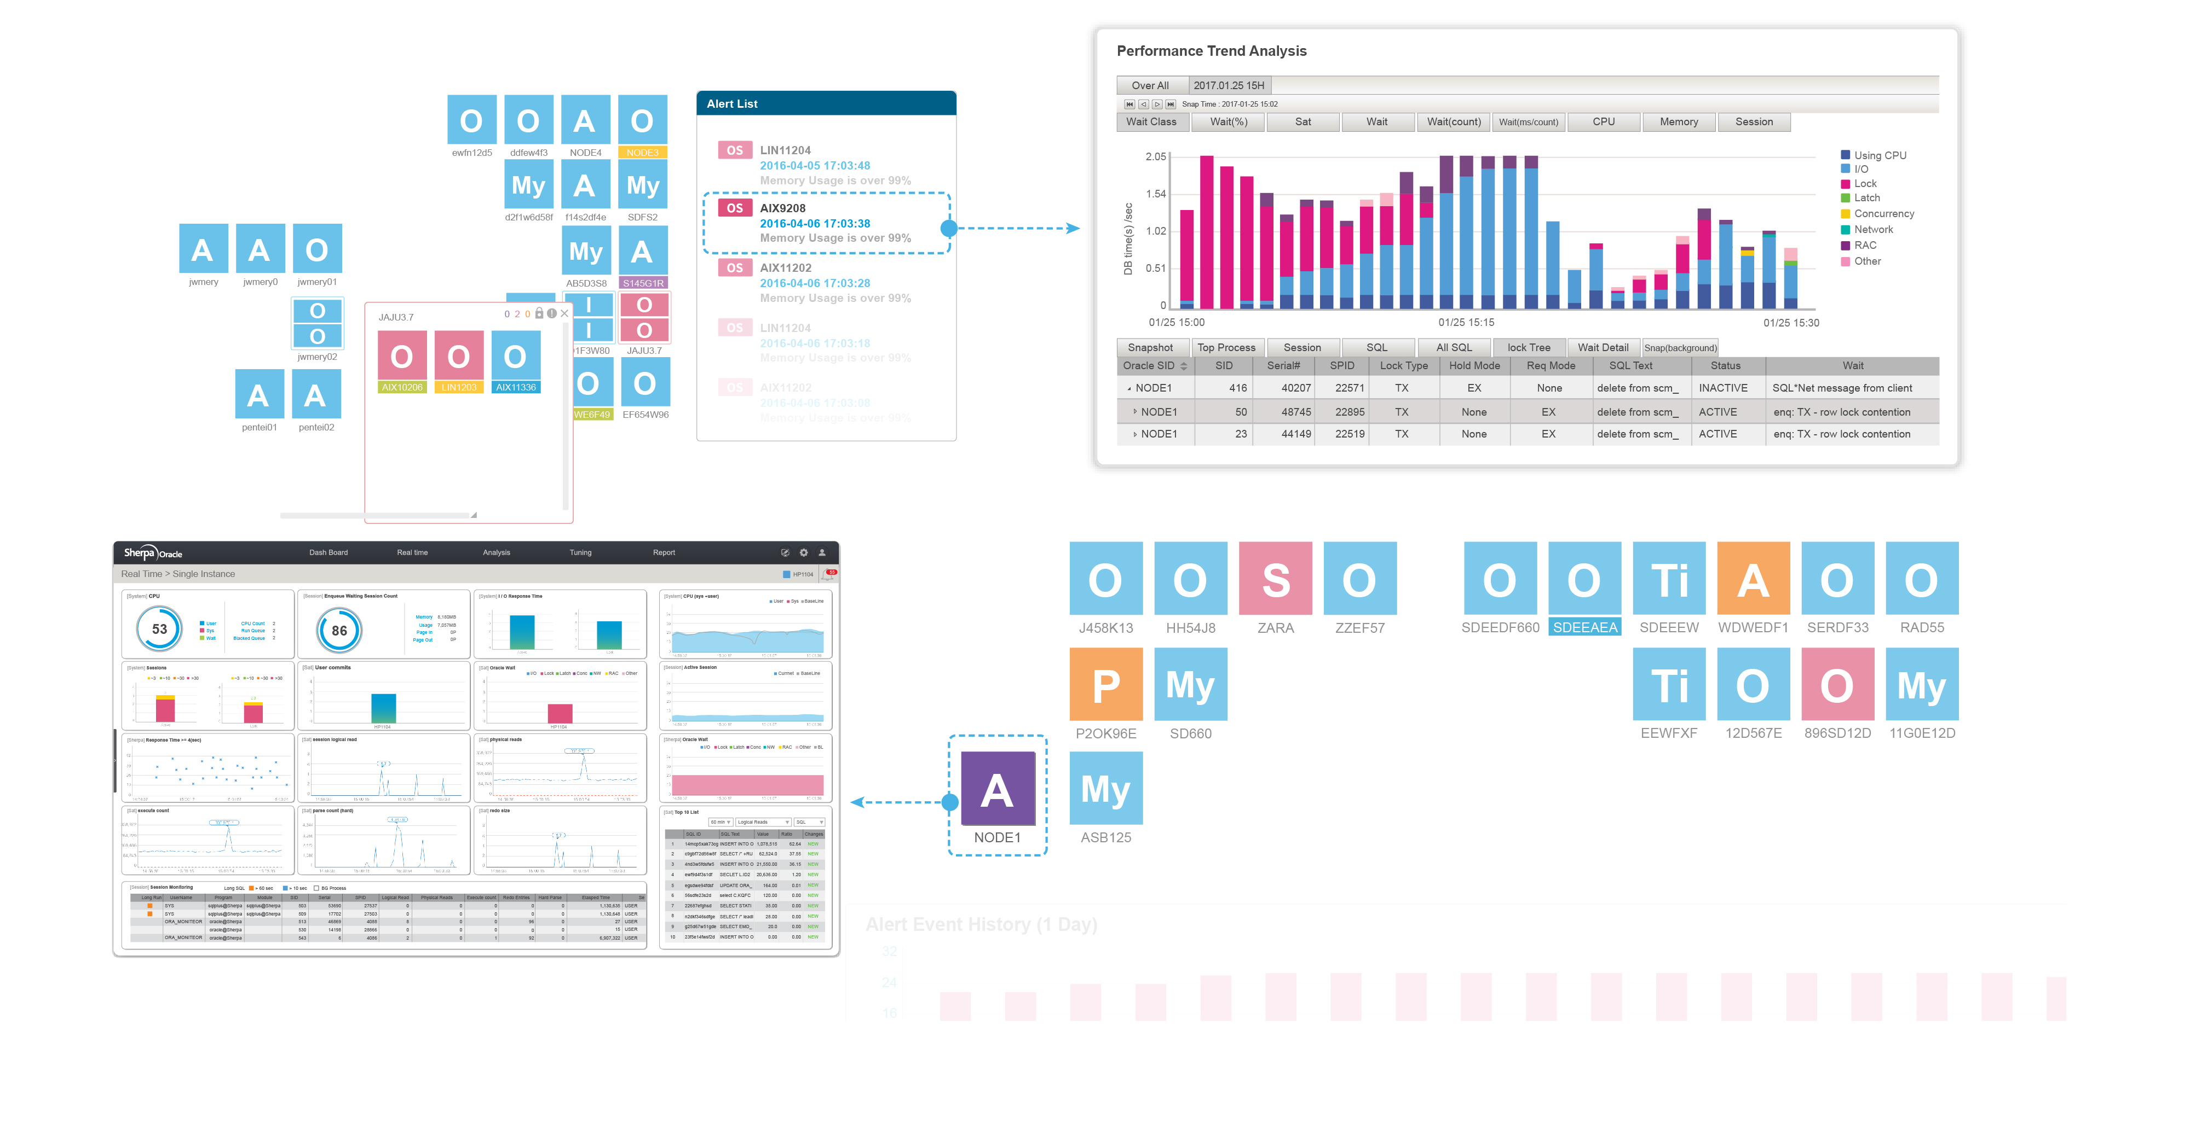

Slide 12
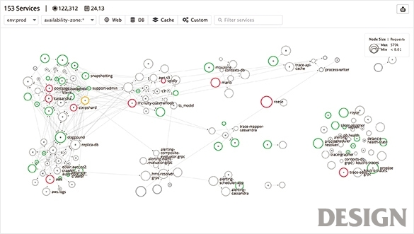
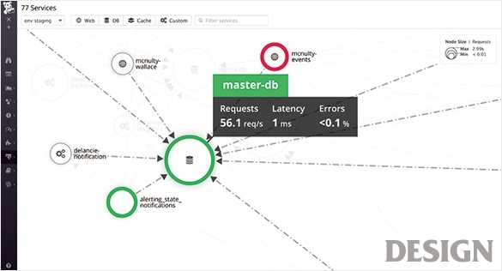
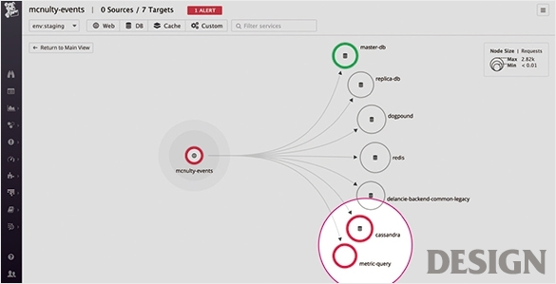

Slide 13
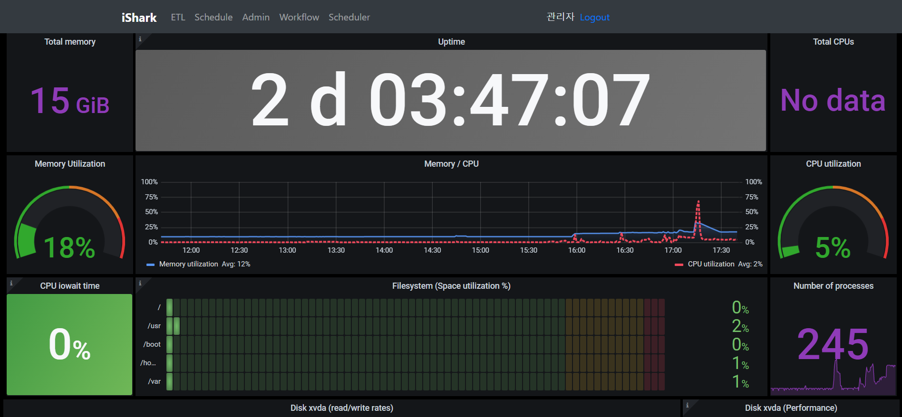
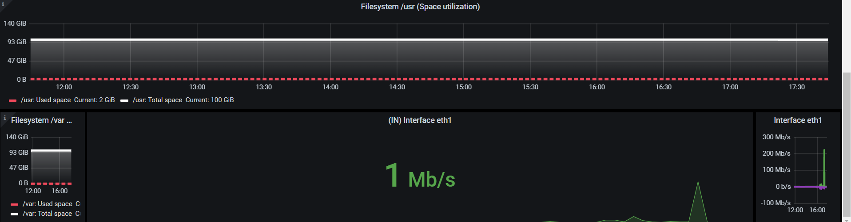

Slide 14
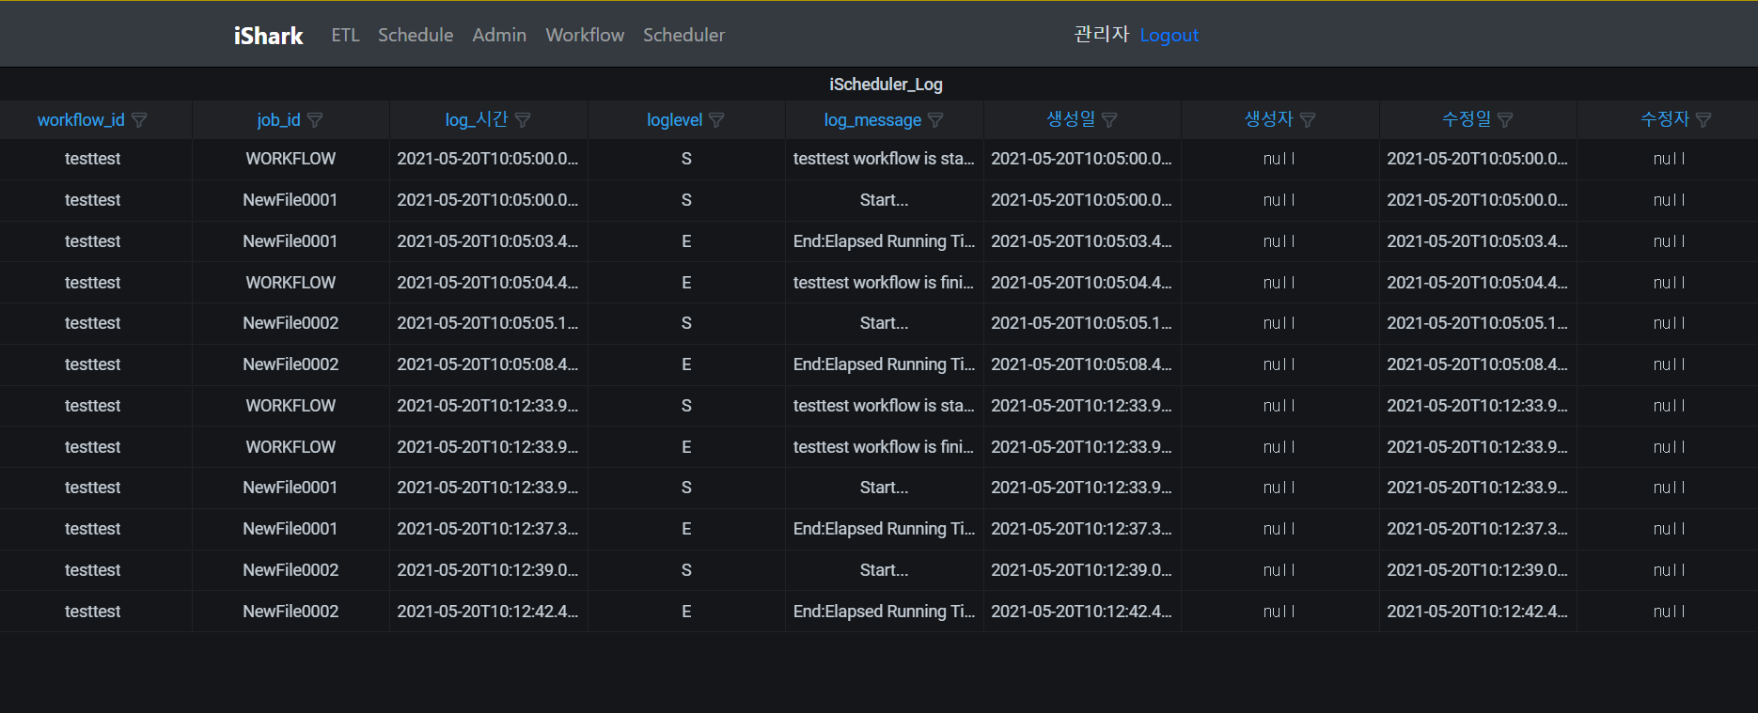
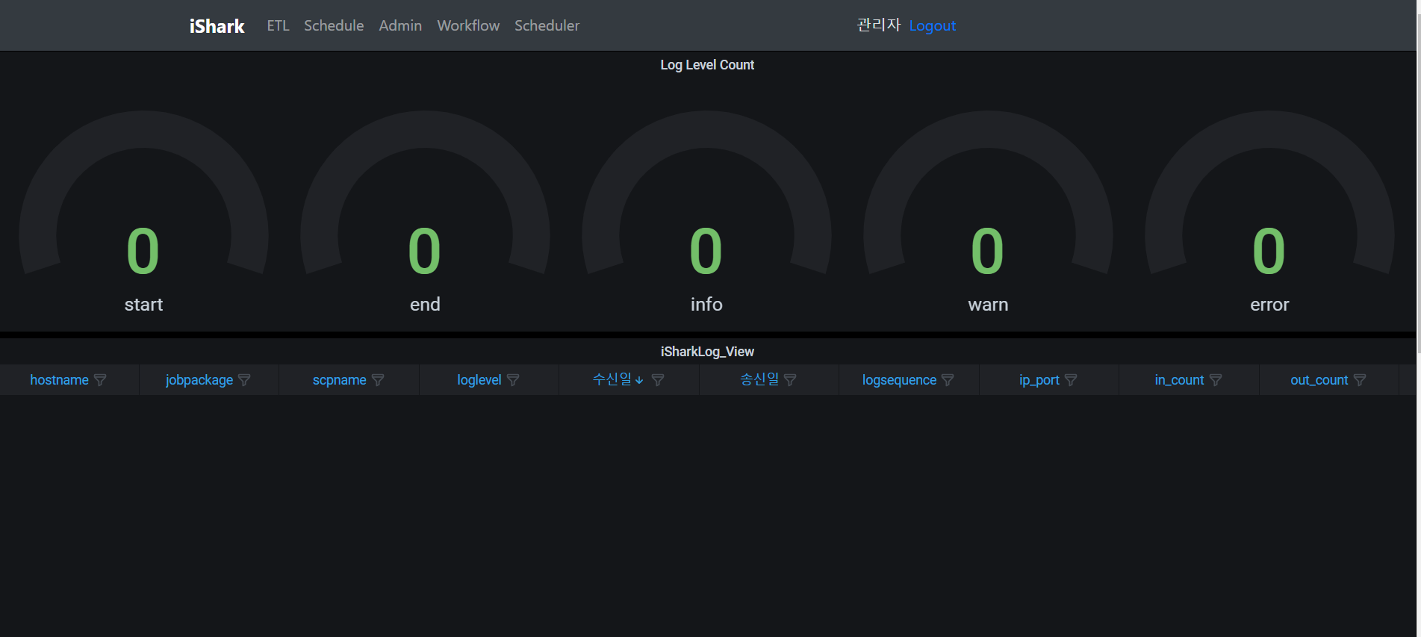

Slide 15
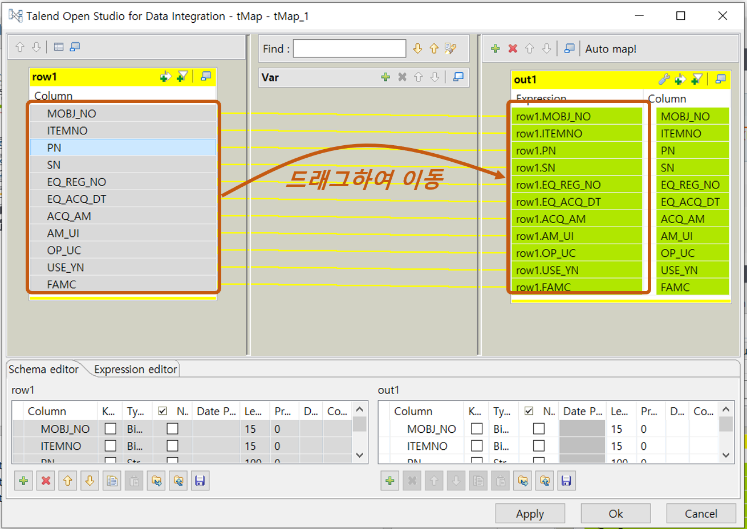
- 현재 ishark에 없는 기능

Slide 16
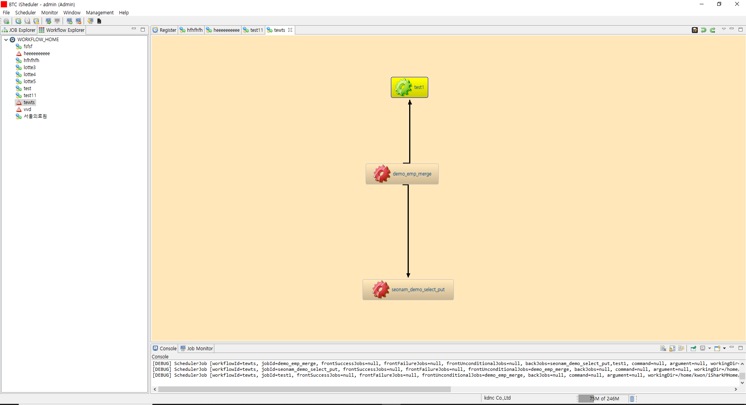

Slide 17
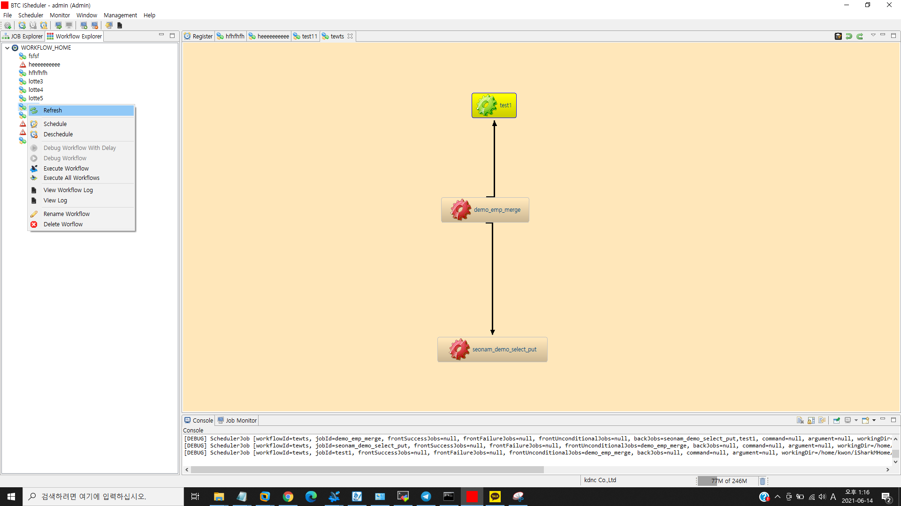

Slide 18
